Slide 1
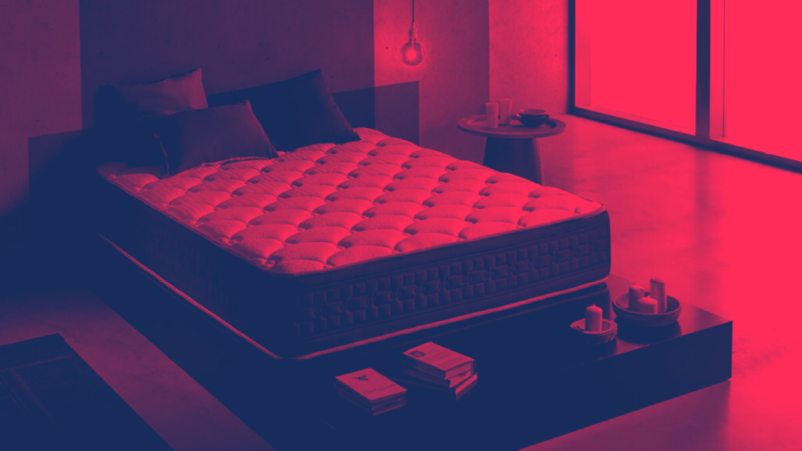

Rosen is a Chilean multinational company dedicated to the manufacture of mattresses founded in 1958, it markets its products in 11 Latin American countries.

Slide 2


INSIGHT
INSIGHT
“A mattress improves your place to dream”

Slide 3

IDEA
The idea is to to highlight the dreams that people could have, through the mattresses in order to demonstrate the good quality of the product.

Slide 4
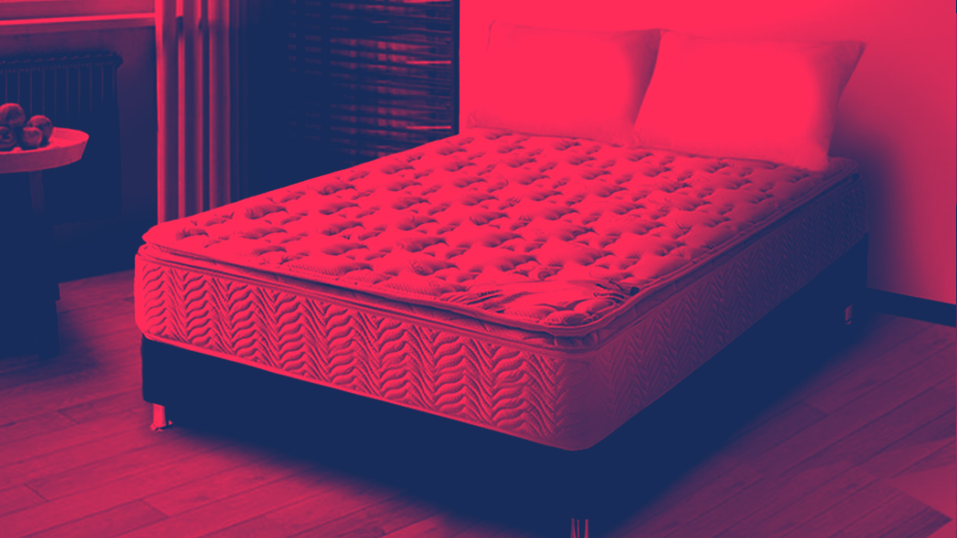
HEADLINE
PIEZAS

Slide 5
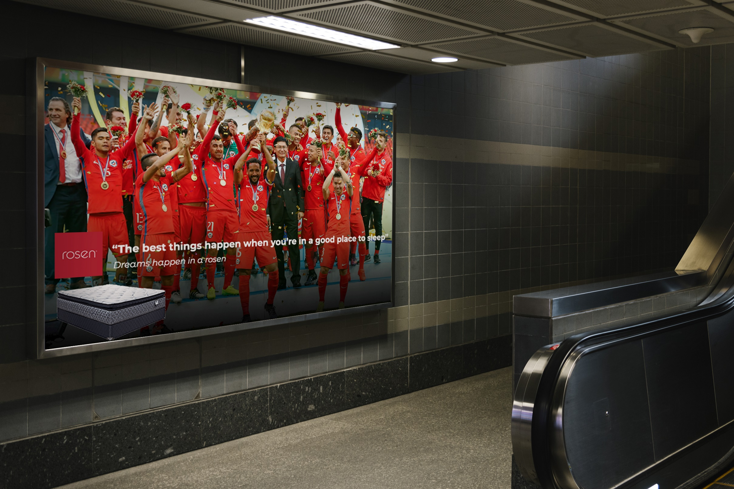

Slide 6
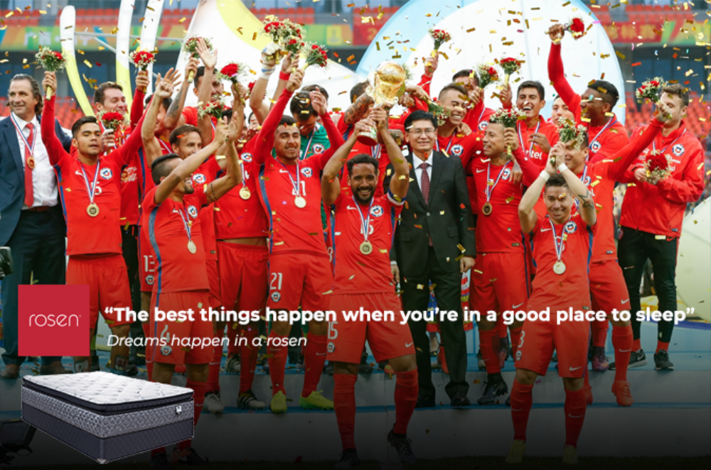

Slide 7


Slide 8
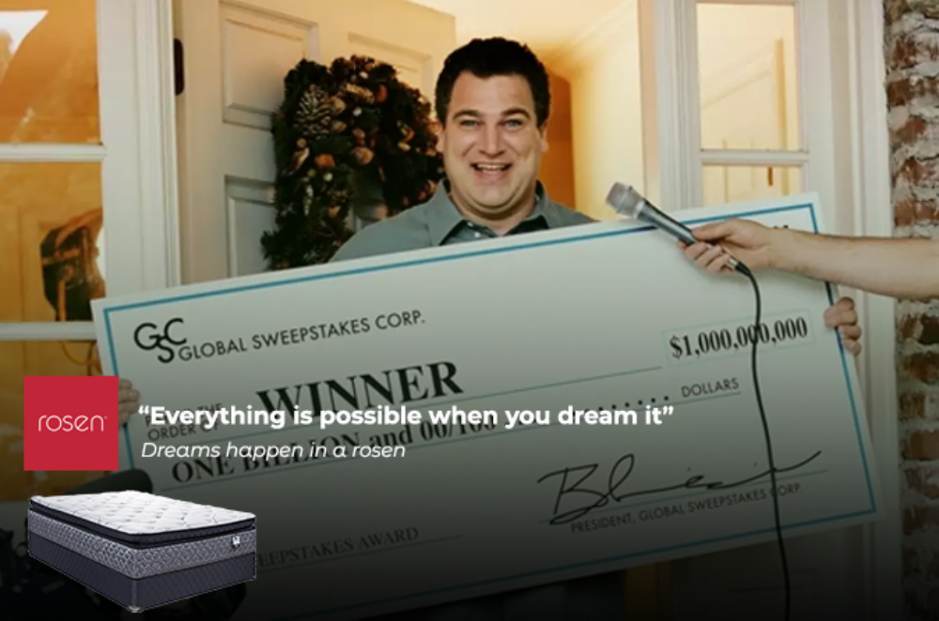

Slide 9
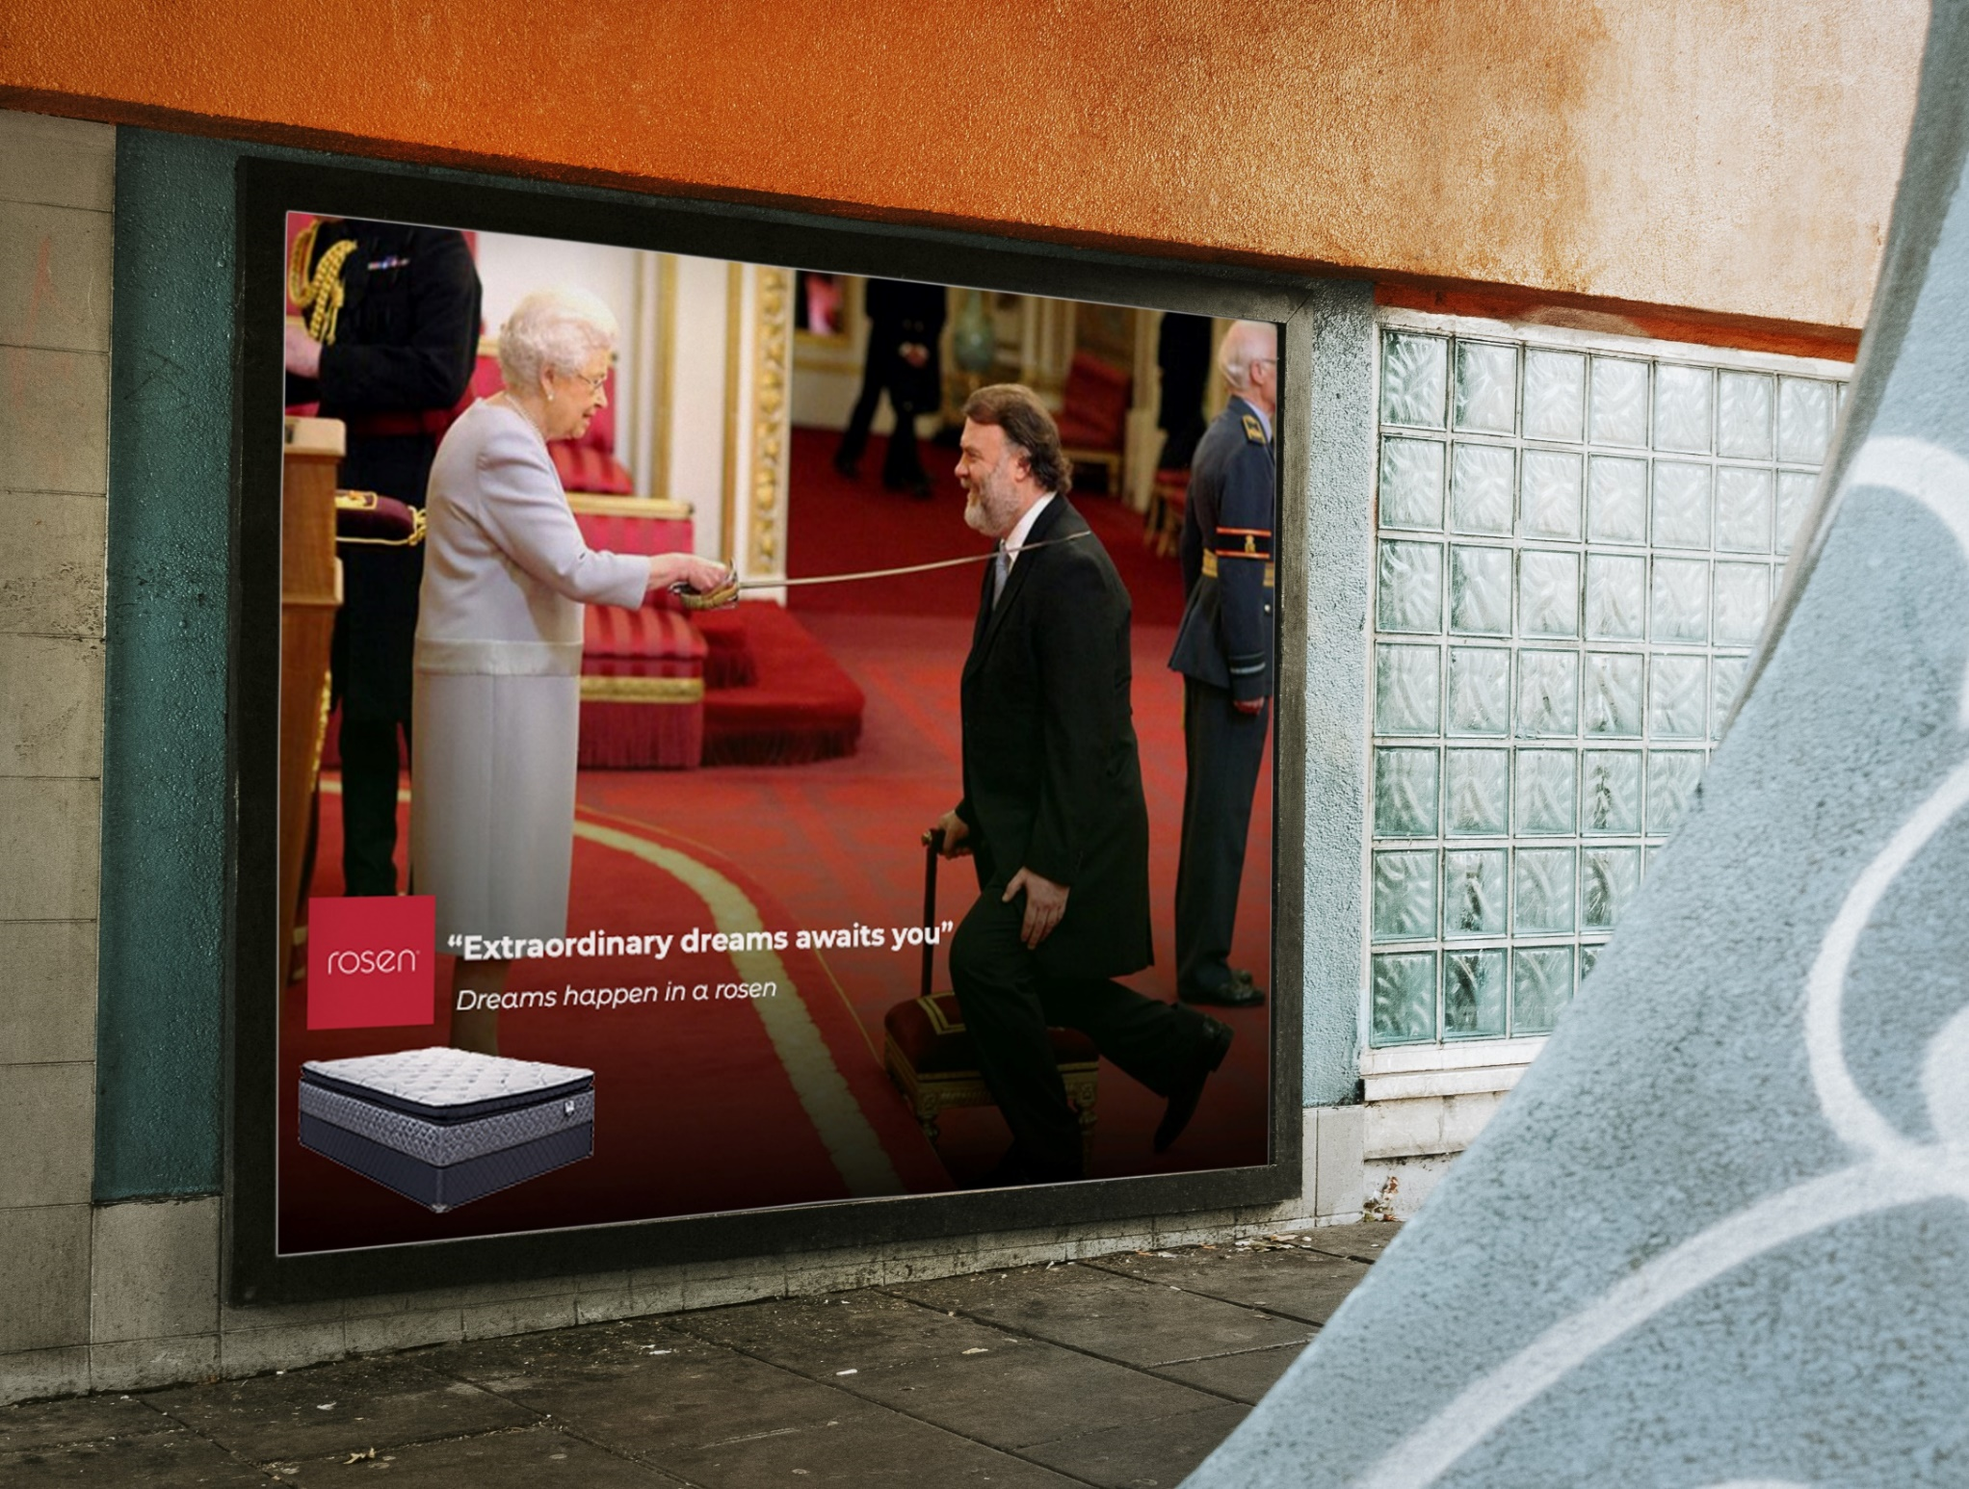

Slide 10
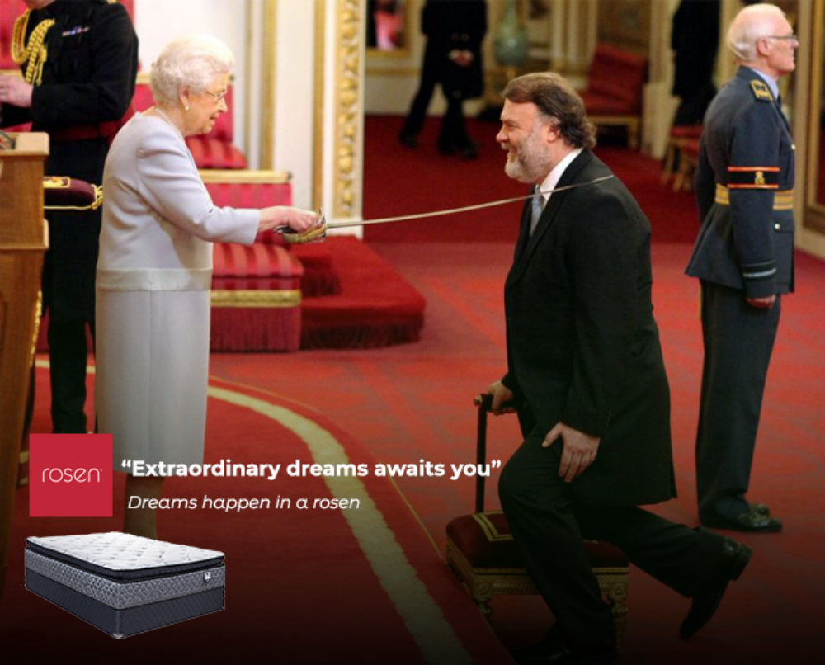

Slide 11
LONG COPY
PIEZAS

Slide 12
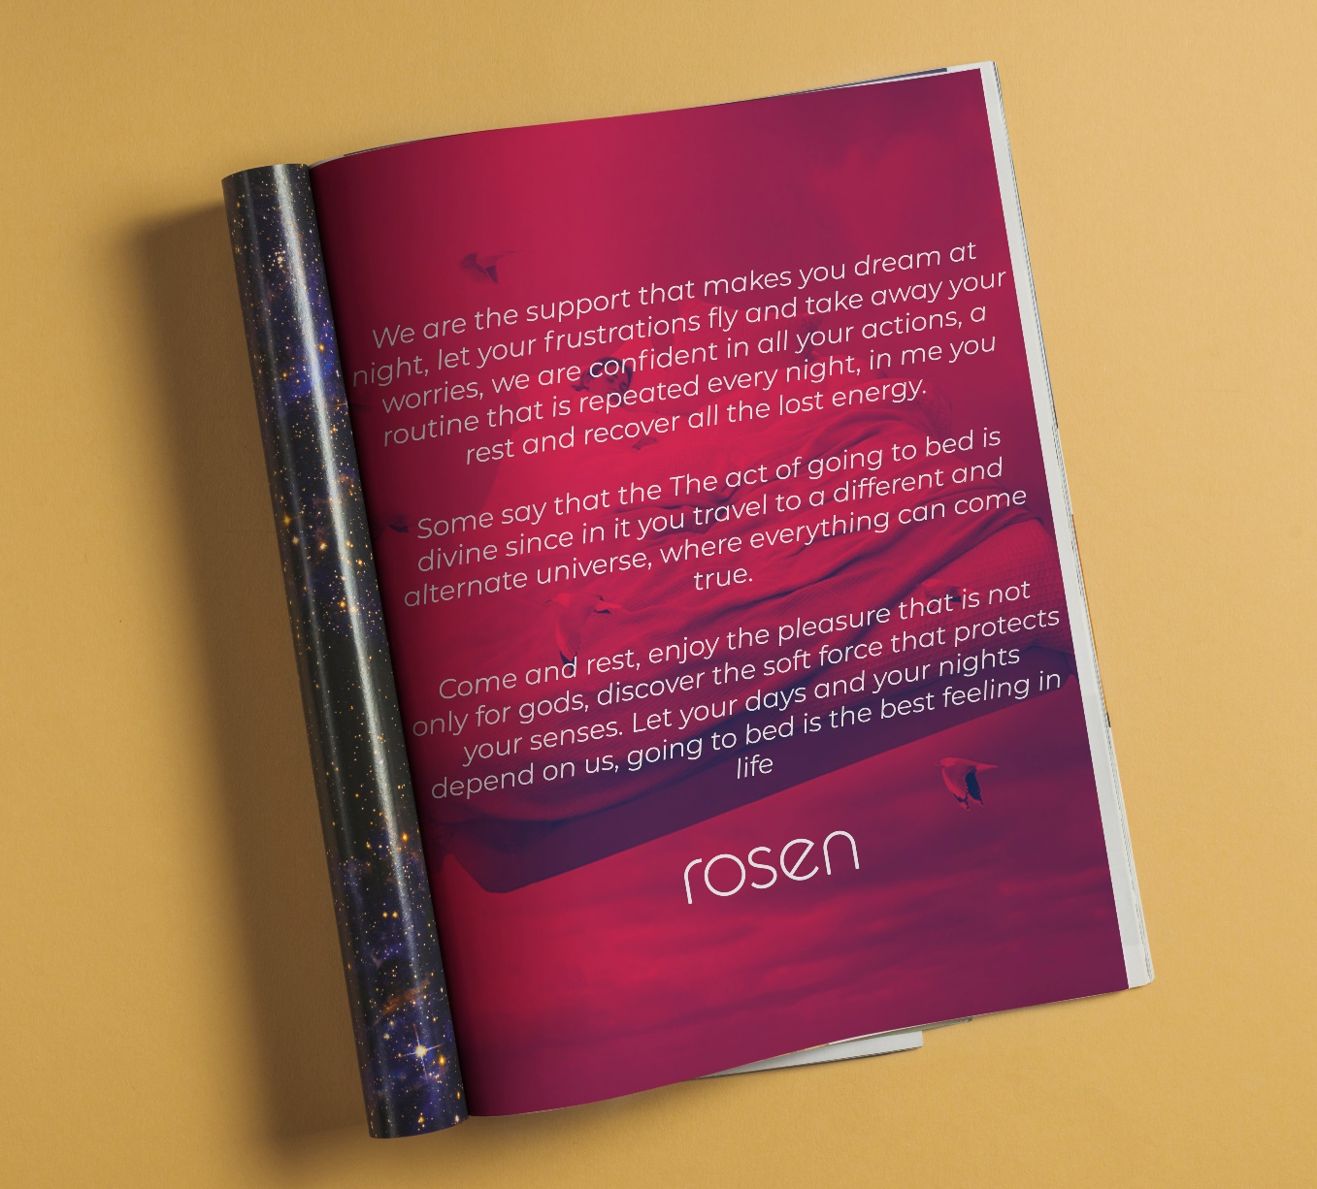

Slide 13
Treatment
PIEZAS

Slide 14

[Crowd can be Heard cheering]
[The scene begins with a man holding and kissing the world cup]
Narrator: Anything is posible….

Slide 15
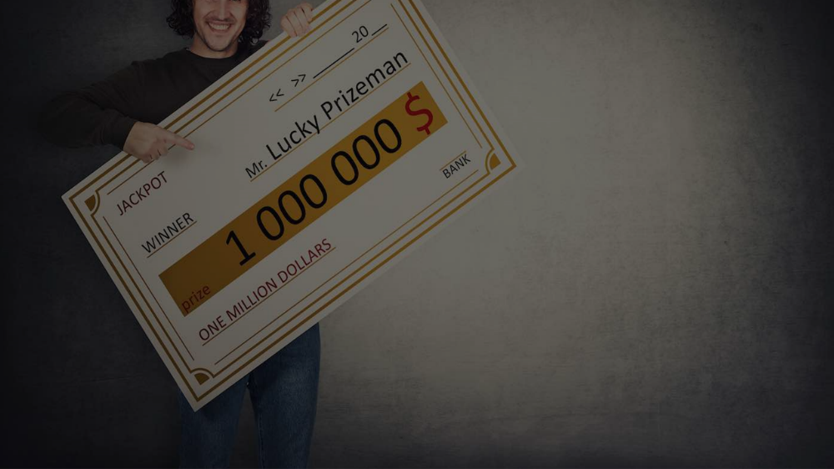
[Scene changes to another stage]
[applause can be Heard]
[The same man is seen smiling, holding a giant check for a million dollars]
Narrator: Anything can happen…

Slide 16

[The scene is changeg again]
[The same man is shown in a royal court being made king of England]
Narrator: Everything can become true…

Slide 17

[The scene changes again]
[The man is seen sleeping on a bed]
[Camara zooms in on the happy face of the man]
Narrator: If you’re in the right place, mattresse Rosen

Slide 18
Digital activation
PIEZAS

Slide 19
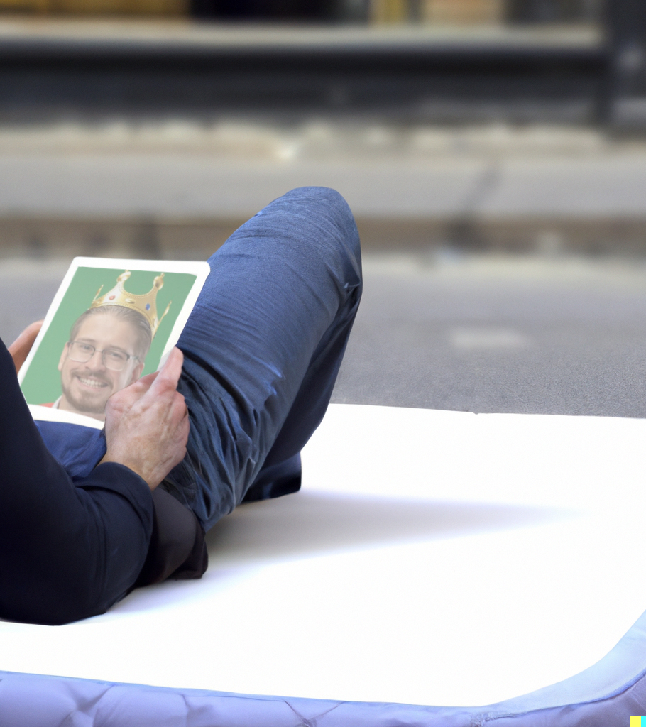
DREAMEKER MATRESSES.
EVERYTHING YOU DREAM WILL COME TRUE
The idea is to carry out an activation in the street where, through a mattress and a touch screen, people will be able to relax on the mattress and enter their dreams on the tablet, for example, “to be king”. Then this screen will take a photo of them and through artificial intelligence, they will be portrayed. Later the image can be downloaded and uploaded to social networks.

